Slide 1
April 22 - May 3, 2024
Citadines Millennium Ortigas Manila

Slide 2
National Anthem

Slide 3
Acknowledgments

Slide 4

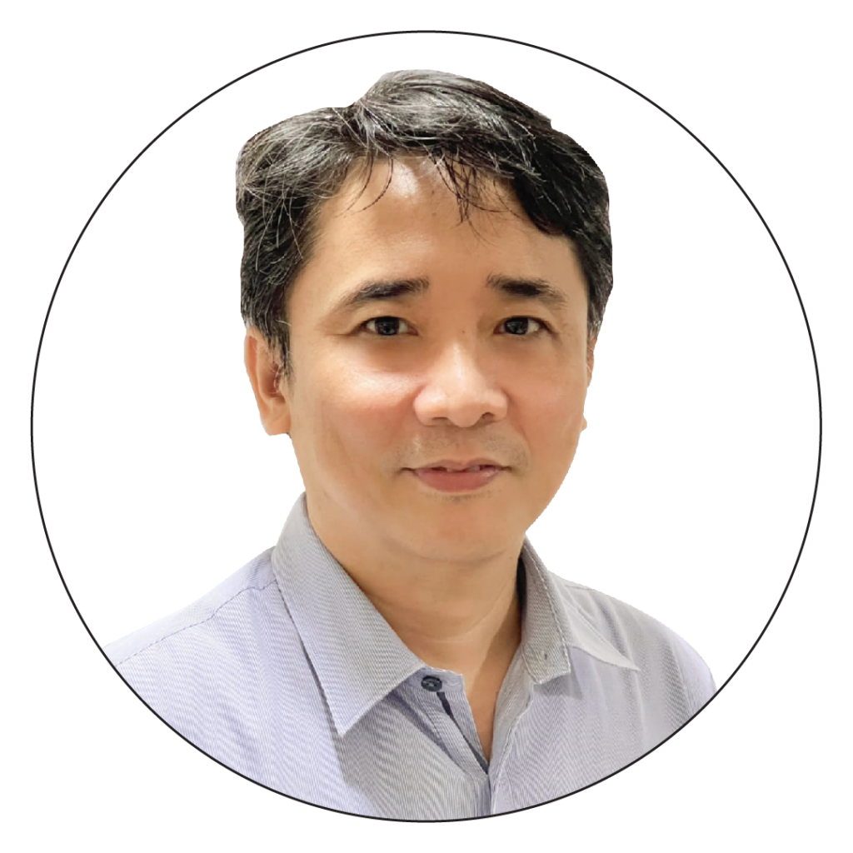
Opening Remarks
RODERICK M. PLANTA
Assistant Secretary
National Economic and Development Authority
Investment Programming Group

Slide 5
Opening Remarks
DR. SELVA RAMACHANDRAN
United Nations Development Programme

Slide 6
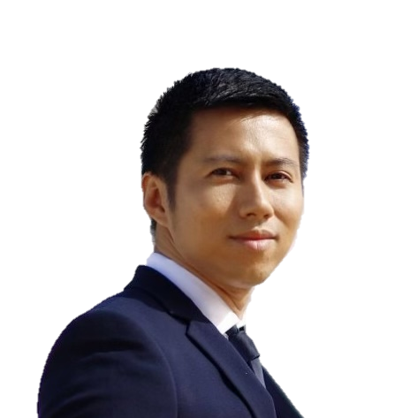
Background and Rationale
ALDWIN U. URBINA
OIC-Director and Acting Manager
National Economic and Development Authority
Monitoring and Evaluation Staff
Central Evaluation Unit

Slide 7
What is the Six-Year Evaluation Agenda (SYEA)?
crafted by the NEDA-IPG, through the Central Evaluation Unit (CEU)
reflects IPG's commitments to contribute to engendering an evaluation culture in the public sector
it is designed to help enhance the implementation, updating, and assessment of the PDP by providing the necessary evidence concerning the progress, completion, outcome, and impact of the government policies, programs, and projects in pursuit of national development goals

Slide 8
Strategic focus areas of the SYEA
1
Building competence and confidence of individuals to enable the creation and use of evaluations
2
Curating and creating knowledge and incorporation of evaluation results in government processes
3
Communications and community to foster the culture of learning

Slide 9
What is the Capacity Development on Impact Evaluation?
An initiative of NEDA - Investment Programming Group (IPG), which aims to increase NEDA regional capacities to plan, manage, and utilize IMPACT EVALUATIONS.
It is part of a larger effort to build the competence and confidence of individuals and institutions to enable the creation and use of evaluations in the public sector under the NEDA-IPG's Six-Year Evaluation Agenda (SYEA).

Slide 10
Objectives of the Capacity Development on Impact Evaluation
1
Build local expertise on impact evaluation in the regions
Produce a body of knowledge/evidence that will inform the implementation and updating of the Philippine Development Plan (PDP)
2

Slide 11

Course Overview, House Rules, Protocols and Pre-Test

Slide 12
Technical Course on Impact Evaluation
Course Overview
April 22 – May 3, 2024, Citadines Millennium Ortigas, Ortigas Center

Slide 13
House Rules

Slide 14
Session Proper
Join the Google Classroom.
Be punctual. Registration starts at 8:00 everyday. Sessions will begin promptly at 8:15.
Observe proper dress code (smart or business casual).
Keep your mobile phones on silent mode. When taking calls, kindly step outside of the function room.
Listen and participate actively.
Avoid unnecessary chatter during lectures.
Respect each other at all time.

Slide 15
Certificates
Certificate of Completion will be awarded to participants who successfully attended all sessions and submitted all required outputs.
Certificate of Completion | Present in all sessions Submitted training output
Certificate of Participation | Present in 6-9 sessions Submitted training output
Certificate of Appearance | Present in 5 sessions or less Submitted training output

Slide 16
Health and Safety Protocols
Wearing of facemask is encouraged, especially when not eating, presenting, or discussing.
As much as possible, refrain from leaving the hotel premises after each session.

Slide 17
Meals
Breakfast - 6:00am - 10:00am (Hotel Restaurant)
Lunch - 12:00nn - 01:00pm (Picasso Function Room)
Dinner - 06:00pm - 09:00pm (Picasso Function Room)

Slide 18
SAFETY AND SECURITY PROTOCOLS

Slide 19
Pre-Test QR Code
pretest.nedacapdev.codes

Slide 20
Health Break

Slide 21
Module 1 Introduction to Impact Evaluation

Slide 22
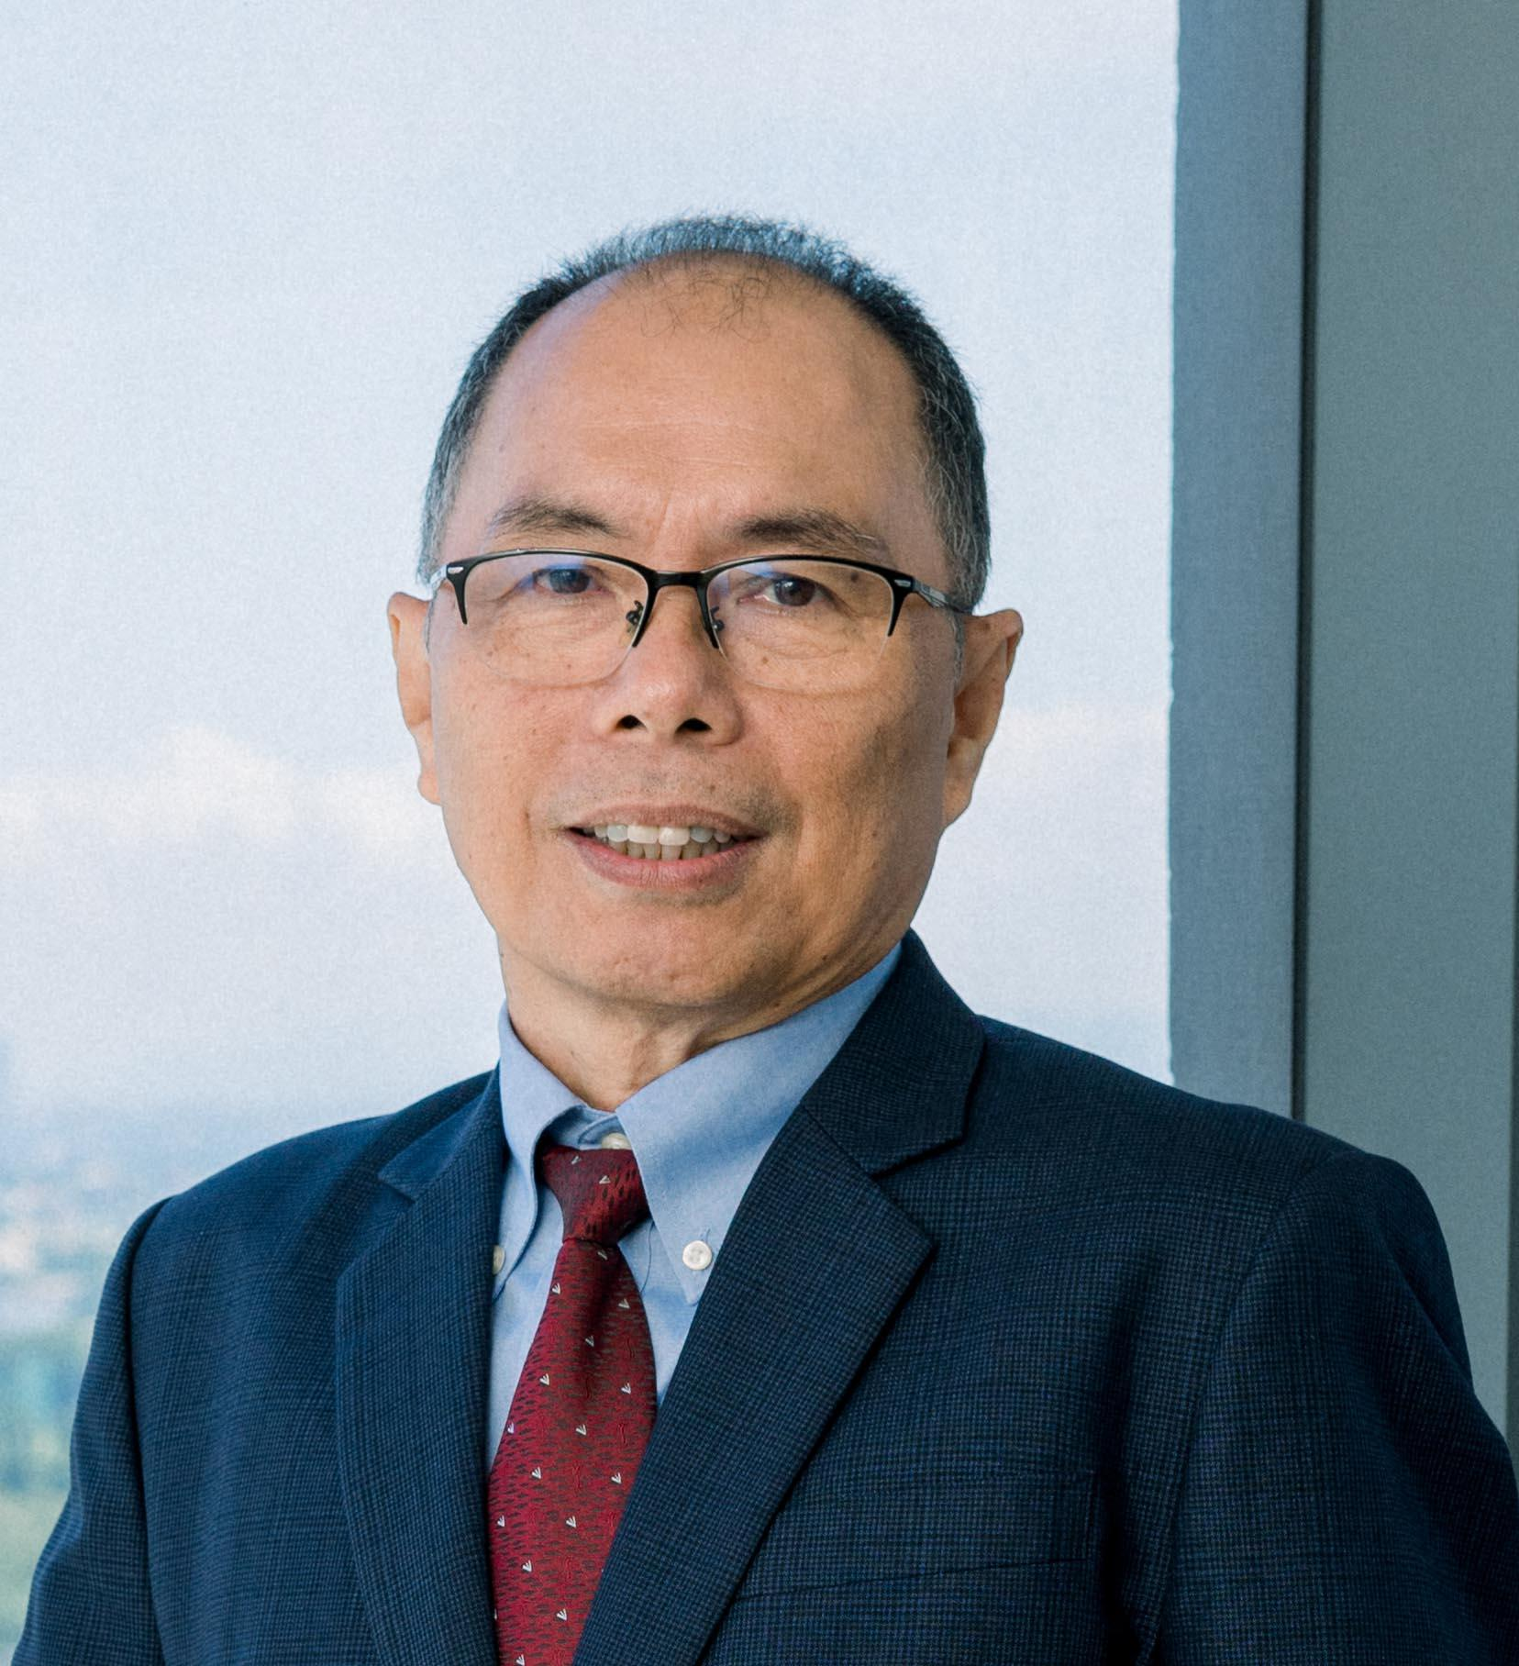
SESSION 1.1 Impact Evaluation for the Public Sector (What, Why, & When)
DR. ANICETO C. ORBETA, JR.
President
Philippine Institute for Development Studies

Slide 23
Lunch Break

Slide 24
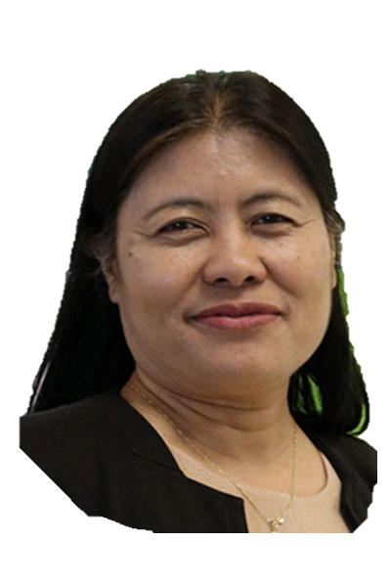
SESSION 2.1 Theoretical Framework, Theory of Change (ToC), Formulating Evaluation Questions
DR. MARITES M. TIONGCO
Full Professor and Dean
De La Salle University
College of Economics

Slide 25
Day 1 Wrap-up and Key Takeaways

Slide 26
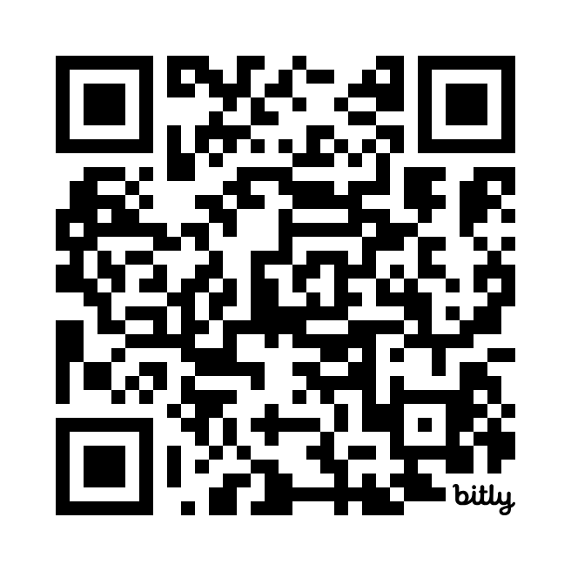
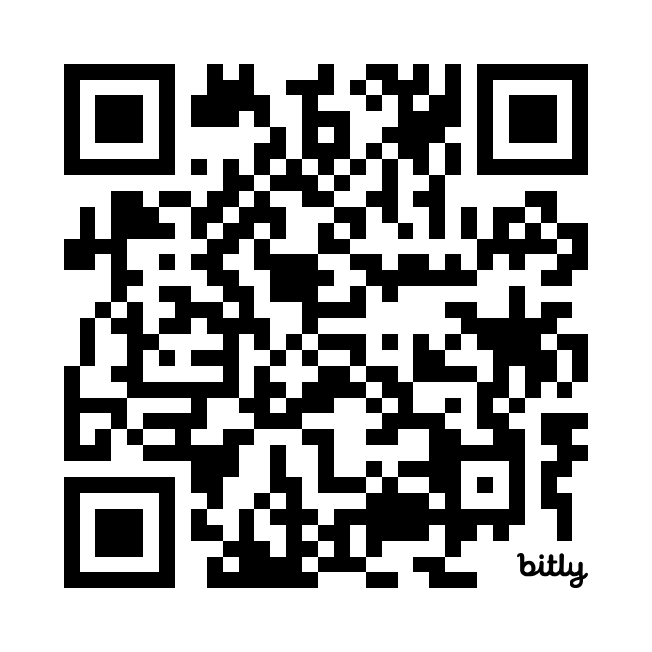
Day 1
Feedback Forms
Session 1.1
Dr. Aniceto Orbeta
Session 2.1
Dr. Marites Tiongco

Slide 27
Module 2 Preparation for an Impact Evaluation

Slide 28
WORKSHOP 2.1 Developing Theory of Change (ToC) and Research Questions
DR. MARITES M. TIONGCO
Full Professor and Dean
De La Salle University
College of Economics

Slide 29
Health Break

Slide 30
Jeopardy!

Slide 31
Lunch Break

Slide 32
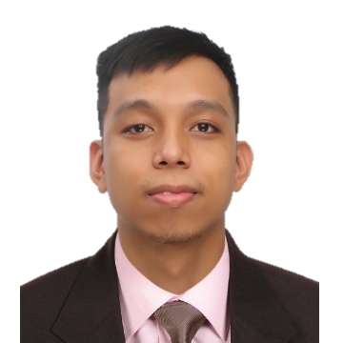
SESSION 2.2 Indicators and Data
ADRIAN MATTHEW G. GLOVA
Assistant Professor University of the Philippines School of Statistics

Slide 33
Day 2 Wrap-up and Key Takeaways

Slide 34
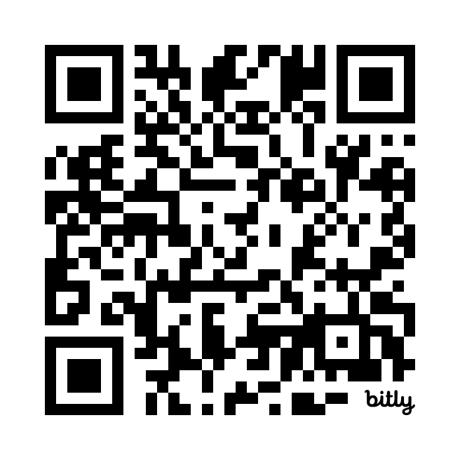
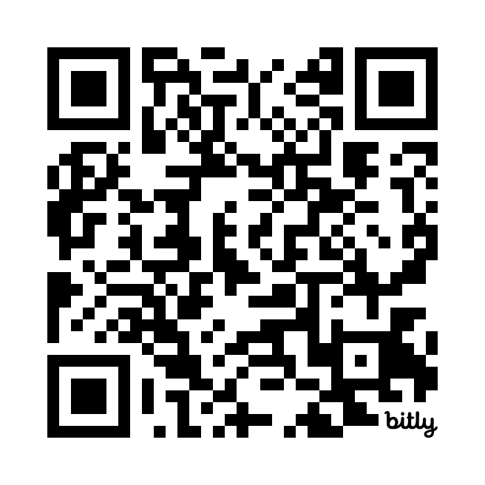
Day 2
Feedback Forms
Workshop 2.1
Dr. Marites Tiongco
Session 2.2
Mr. Adrian Glova

Slide 35
Answer this form!

Slide 36
WORKSHOP 2.2 Research Hypotheses, Indicators, Data Collection Plan
ADRIAN MATTHEW G. GLOVA
Assistant Professor University of the Philippines School of Statistics

Slide 37
Health Break

Slide 38
Lunch Break

Slide 39
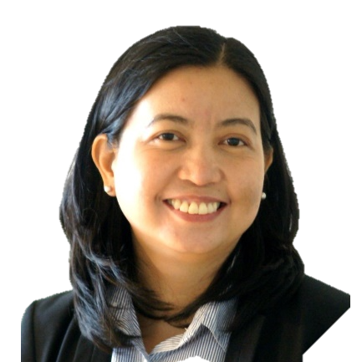
WORKSHOP 2.2 Research Hypotheses, Indicators, Data Collection Plan
DR. ALELLIE B. SOBREVIÑAS
Associate Professor
De La Salle University
School of Economics

Slide 40
Day 3 Wrap-up and Key Takeaways

Slide 41
Day 3 Session Evaluation QR Codes

Slide 42
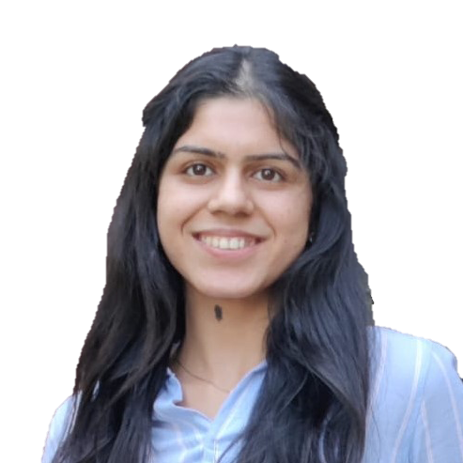
SESSION 3.2 Introduction to Experimental Design
SOUMYA KOCHHAR
Research Manager Innovations for Poverty Action

Slide 43
Health Break

Slide 44
Lunch Break

Slide 45
SESSION 3.3 Introduction to Quasi-Experimental Design
DR. MARITES M. TIONGCO
Full Professor and Dean
De La Salle University
College of Economics

Slide 46
Health Break

Slide 47
Module 3 How to Conduct an Impact Evaluation

Slide 48
Day 4 Wrap-up and Key Takeaways

Slide 49
Day 4 Session Evaluation QR Codes

Slide 50
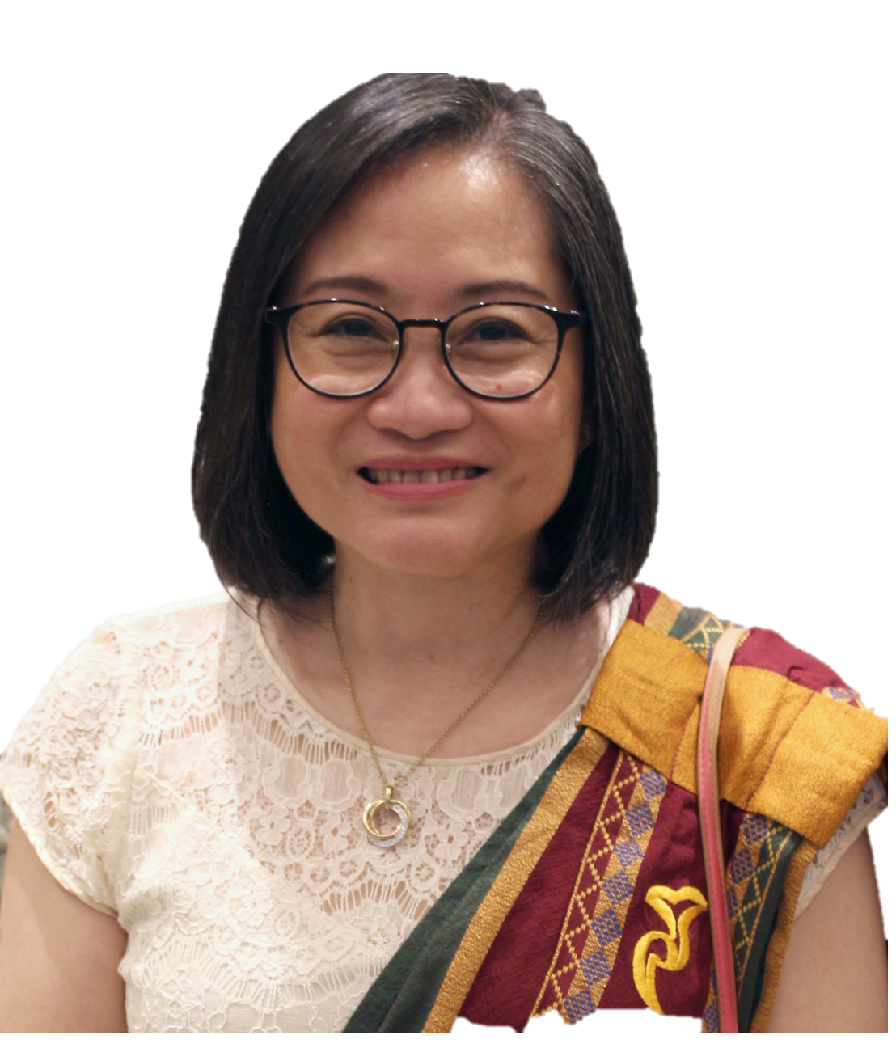
SESSION 3.4 Instrumental Variable (IV)
DR. ALELI D. KRAFT
Assistant Professor University of the Philippines School of Statistics

Slide 51
Health Break

Slide 52
Lunch Break

Slide 53
SESSION 3.4 Instrumental Variable (IV)
DR. ALELI D. KRAFT
Assistant Professor University of the Philippines School of Statistics

Slide 54
Health Break

Slide 55
Day 5 Wrap-up and Key Takeaways

Slide 56
Day 5 Session Evaluation QR Codes

Slide 57
SESSION 3.6 Propensity Score Matching (PSM)
ADRIAN MATTHEW G. GLOVA
Assistant Professor University of the Philippines School of Statistics

Slide 58
Health Break

Slide 59
Lunch Break

Slide 60
SESSION 3.7 Difference-in-Difference (DiD)
DR. MARITES M. TIONGCO
Full Professor and Dean
De La Salle University
College of Economics

Slide 61
Health Break

Slide 62
Day 6 Wrap-up and Key Takeaways

Slide 63
Day 6 Session Evaluation QR Codes

Slide 64
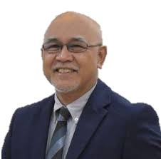
SESSION 3.9 Do’s and Don'ts in Designing an Impact Evaluation Study
JOSEPH J. CAPUNO
Undersecretary
National Economic and Development Authority - Investment Programming Group

Slide 65
Health Break

Slide 66
Lunch Break

Slide 67
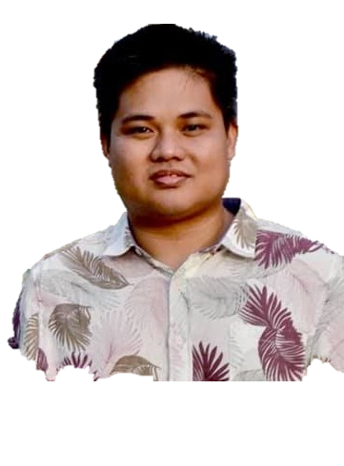
SESSION 3.8 Synthetic Control (SC)
DR. KARL JANDOC
Associate Professor
University of the Philippines
School of Economics

Slide 68
Health Break

Slide 69
Day 6 Wrap-up and Key Takeaways

Slide 70
Day 6 Session Evaluation QR Codes

